Slide 1
Optimal PrEP distribution among multiple cities of Brazil for minimizing HIV-AIDS transmissions in high-risk homosexual men
Vijeta Deshpande
3rd October 2020

Slide 2
Overview
Background
Motivation
Impact measurement
Problems associated with resource-allocation
Research question
Breaking the problem into two steps
Problem formulation
Results
Discussion
Questions

Slide 3
Background
Origin of the incident cases of HIV-AIDS in Brazil
In 2017, 33,000 new cases out of 48,000 total, were men
Men who have sex with men (MSM) are at much higher risk
Incidence among MSM is estimated to be 5/100PY (whereas, 0.02/100PY for general population)
Pre-Exposure Prophylaxis (PrEP)
Cost-effective over the incidence of 0.9/100PY in Brazil
Accompanied with testing to bring individuals in care
Policy decisions from Brazil government
Since 2018, PrEP is available for selected population, free of cost

Slide 4
Motivation
Impact of PrEP uptake
Detailed profiling of HIV-AIDS epidemic in each city
Parameters of acquisition risk, transmission network, prevalence, testing mechanism and ART treatment were tuned to represent epidemic in each city
Simulate few PrEP uptake strategies and measure impact for each in all cities
Making decision from impact measurement
More impact is desirable, but …
Consideration of multiple cities multiplies the solution space

Slide 5








Impact measurement
$$θ_{1}$$
CEPAC
(a Monte-Carlo simulation model)
$$y_{1}$$
$$θ_{2}$$
$$y_{2}$$
$$⋮$$
$$⋮$$
$$θ_{n}$$
$$y_{n}$$

Slide 6





















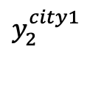
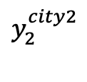




Impact measurement
$$θ_{1}^{city1}$$
CEPAC
$$y_{1}^{city1}$$
$$Solution space$$
$$θ_{2}^{city1}$$
$$y_{2}^{city1}$$
$$θ_{y}$$
$$θ_{x}$$
$$⋮$$
$$⋮$$
$$θ_{z}$$
$$θ_{n}^{city1}$$
$$y_{n}^{city1}$$
$$θ_{1}^{city2}$$
CEPAC
$$y_{1}^{city2}$$
$$θ_{2}^{city2}$$
$$y_{2}^{city2}$$
$$⋮$$
$$⋮$$
$$θ_{n}^{city2}$$
$$y_{n}^{city2}$$
$$⋮$$
$$θ_{1}^{city3}$$
CEPAC
$$y_{1}^{city3}$$
$$θ_{2}^{city3}$$
$$y_{2}^{city3}$$
$$⋮$$
$$⋮$$
$$θ_{n}^{city3}$$
$$y_{n}^{city3}$$

Slide 7

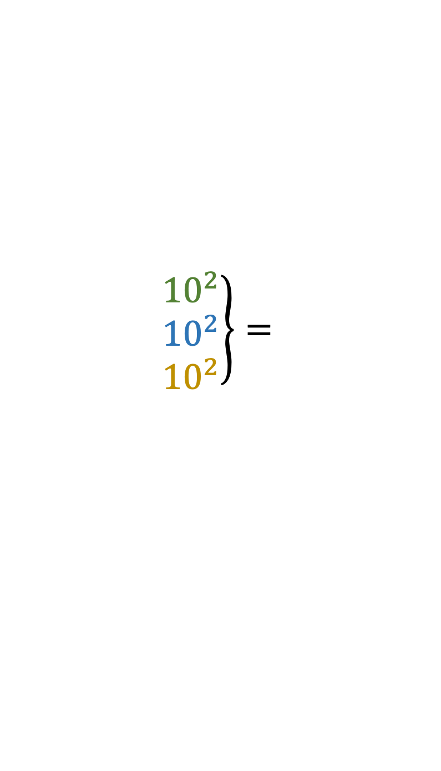

Finding best decision
$$θ_{1}^{city1}$$
CEPAC
$$y_{1}^{city1}$$
$$Solution space$$
$$θ_{2}^{city1}$$
$$y_{2}^{city1}$$
$$⋮$$
$$⋮$$
$$θ_{n}^{city1}$$
$$y_{n}^{city1}$$
$$θ_{1}^{city2}$$
CEPAC
$$y_{1}^{city2}$$
$$\left.\begin{matrix}{10}^{2} \\ {10}^{2} \\ {10}^{2}\end{matrix}\right\}=$$
$$θ_{2}^{city2}$$
$$y_{2}^{city2}$$
$$={10}^{6}$$
$$⋮$$
$$⋮$$
$$⋮$$
$$θ_{n}^{city2}$$
$$y_{n}^{city2}$$
$$θ_{1}^{city3}$$
CEPAC
$$y_{1}^{city3}$$
$$θ_{2}^{city3}$$
$$y_{2}^{city3}$$
$$⋮$$
$$⋮$$
$$θ_{n}^{city3}$$
$$y_{n}^{city3}$$

Slide 8







Finding best decision
$$θ_{1}^{city1}$$
$$y_{1}^{city1}$$
$$Optimal?$$
CEPAC
$$Solution space$$
$$θ_{2}^{city1}$$
$$y_{2}^{city1}$$
$$⋮$$
$$⋮$$
$$θ_{3}^{city1}$$
$$y_{3}^{city1}$$
$$θ_{1}^{city2}$$
CEPAC
$$y_{1}^{city2}$$
$$\left.\begin{matrix}{10}^{2} \\ {10}^{2} \\ {10}^{2}\end{matrix}\right\}=$$
$$θ_{2}^{city2}$$
$$y_{2}^{city2}$$
$$={10}^{6}$$
$$⋮$$
$$⋮$$
$$⋮$$
$$θ_{3}^{city2}$$
$$y_{3}^{city2}$$
$$θ_{1}^{city3}$$
CEPAC
$$y_{1}^{city3}$$
$$θ_{2}^{city3}$$
$$y_{2}^{city3}$$
$$⋮$$
$$⋮$$
$$θ_{3}^{city3}$$
$$y_{3}^{city3}$$

Slide 9
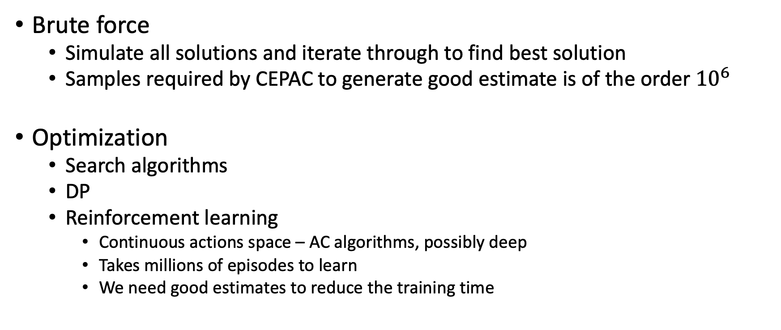
Problems associated with resource-allocation
Brute force
Simulate all solutions and iterate through to find best solution
Samples required by CEPAC to generate good estimate is of the order ${10}^{6}$
Optimization
Search algorithms
DP
Reinforcement learning
Continuous actions space – AC algorithms, possibly deep
Takes millions of episodes to learn
We need good estimates to reduce the training time

Slide 10


Problems associated with RL
Expensive and noisy environment
Expensive learning loop
Environment
(Monte-Carlo simulation model)
$$s_{t+1}, r_{t}$$
$$a_{t}$$
Agent
(NN for value function and NN for policy)

Slide 11




Breaking problem into two steps
Environment
(Monte-Carlo simulation model)
Environment
(Monte-Carlo simulation model)
$$s_{t+1}, r_{t}$$
$$a_{t}$$
Function approximation
(NN model)
Agent
(NN for value function and NN for policy)
$$s_{t+1}, r_{t}$$
$$a_{t}$$
Agent
(NN for value function and NN for policy)

Slide 12


Advantages of function approximation
Environment
(Monte-Carlo simulation model)
Parameterized function (NN) can be trained with much less examples than size of solution space
Removing the Monte-Carlo simulations from Agent’s learning loop
Parallel computations from NN
Function approximation
(NN model)
$$s_{t+1}, r_{t}$$
$$a_{t}$$
Agent
(NN for value function and NN for policy)

Slide 13
Approximating Monte-Carlo Simulation
Simulation is sequence of monthly events
Individual level information
Aggregate information
Markovian property
Recurrent Neural Network for sequence approximation
One to many
Many to many

Slide 14
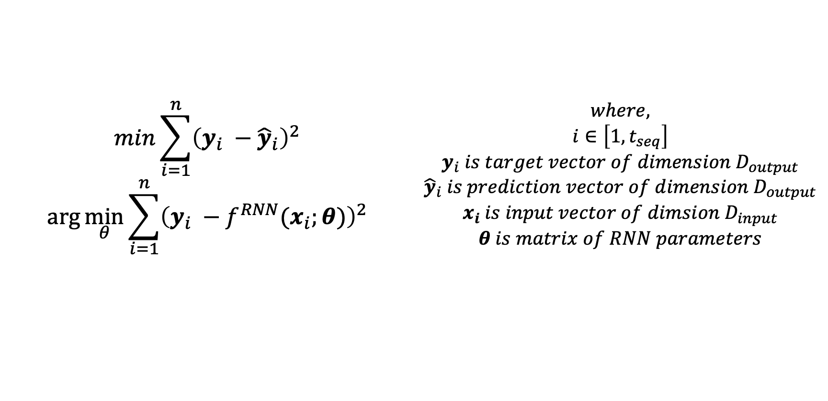

Problem formulation
Prediction
$$\left[x_{t},y_{t−1}\right]\underset{→}{f^{RNN}(⋅)}\left[y_{t}\right]$$
Objective
$$min\sum_{i=1}^{n}{{\left(y_{i} −{\hat{y}}_{i}\right)}^{2}}$$ $$\arg{\min_{θ}{\sum_{i=1}^{n}{{\left(y_{i} −f^{RNN}(x_{i};θ)\right)}^{2}}}}$$ | $$where,$$ $$i∈\left[1, t_{seq}\right]$$ $$y_{i} is target vector of dimension D_{output}$$ $${\hat{y}}_{i} is prediction vector of dimension{ D}_{output}$$ $$x_{i} is input vector of dimsion{ D}_{input}$$ $$θ is matrix of RNN parameters$$

Slide 15
Generation of data
Simulation horizon of five years (time step = 1 month)
Input data
Selected 15 input parameters (out of ~4500) as features of input
Mainly four modules of CEPAC
Sampling
Distribution was either Truncated Normal or Bernoulli
Output data
Selected 3 output parameters as features of output vector
New infections, new transmissions and susceptible population
Size
Simulated 13,000 set of input in CEPAC to generate target dataset
Size of training : validation : test set = 7,800 : 2,600 : 2,600

Slide 16





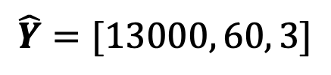








RNN schematic
CEPAC
output
$$Y=[13000, 60, 3]$$
$$y_{1}$$
$$y_{2}$$
$$y_{60}$$
RNN
prediction
$$\hat{Y}=[13000, 60, 3]$$
$${\hat{y}}_{1}$$
$${\hat{y}}_{2}$$
$${\hat{y}}_{60}$$
$$…$$
$$…$$
CEPAC
input
$$X=[13000, 60, 15]$$
$$x_{1}$$
$$x_{2}$$
$$x_{60}$$

Slide 17
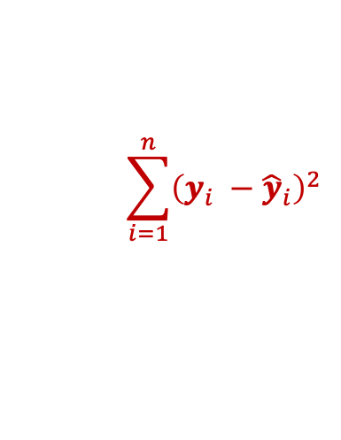
RNN schematic
$$\sum_{i=1}^{n}{{\left(y_{i} −{\hat{y}}_{i}\right)}^{2}}$$
CEPAC
output
$$Y=[13000, 60, 3]$$
$$y_{1}$$
$$y_{2}$$
$$y_{60}$$
RNN
prediction
$$\hat{Y}=[13000, 60, 3]$$
$${\hat{y}}_{1}$$
$${\hat{y}}_{2}$$
$${\hat{y}}_{60}$$
$$…$$
$$…$$
CEPAC
input
$$X=[13000, 60, 15]$$
$$x_{1}$$
$$x_{2}$$
$$x_{60}$$

Slide 18
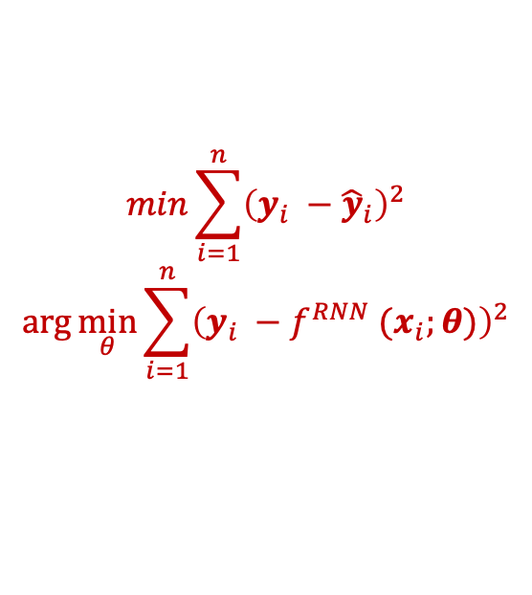

RNN schematic
$$min\sum_{i=1}^{n}{{\left(y_{i} −{\hat{y}}_{i}\right)}^{2}}$$
$$\arg{\min_{θ}{\sum_{i=1}^{n}{{\left(y_{i} −f^{RNN} (x_{i};θ)\right)}^{2}}}}$$
CEPAC
output
$$Y=[13000, 60, 3]$$
$$y_{1}$$
$$y_{2}$$
$$y_{60}$$
RNN
prediction
$$\hat{Y}=[13000, 60, 3]$$
$${\hat{y}}_{1}$$
$${\hat{y}}_{2}$$
$${\hat{y}}_{60}$$
$$…$$
$$…$$
$$θ$$
CEPAC
input
$$X=[13000, 60, 15]$$
$$x_{1}$$
$$x_{2}$$
$$x_{60}$$

Slide 19
Hyperparameter tuning
RNN architecture
Vanilla RNN
Gated Recurrent Unit (GRU)
Long Short-Term Memory (LSTM)
Varying hyperparameters with grid-search
Hyperparameters
Hidden dimension
Number of hidden layers
Learning rate (and reduction schedule)
Dropout rate
Number of training epochs

Slide 20
Results
 | RNN Vanilla | RNN GRU | RNN LSTM
Hidden layer dimension | 32 | 24 | 16
Number of hidden layers | 2 | 2 | 2
Learning rate (at the start of training session) | 0.0006 | 0.0006 | 0.0006
Dropout rate | 0 | 0 | 0
Number of training epochs | 100 | 100 | 100
Mean squared error on test dataset | 0.0097 | 0.0200 | 0.0471

Slide 21
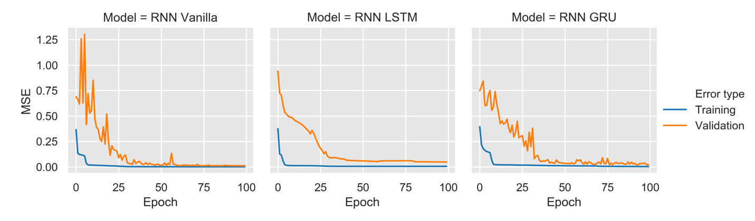
Results

Slide 22
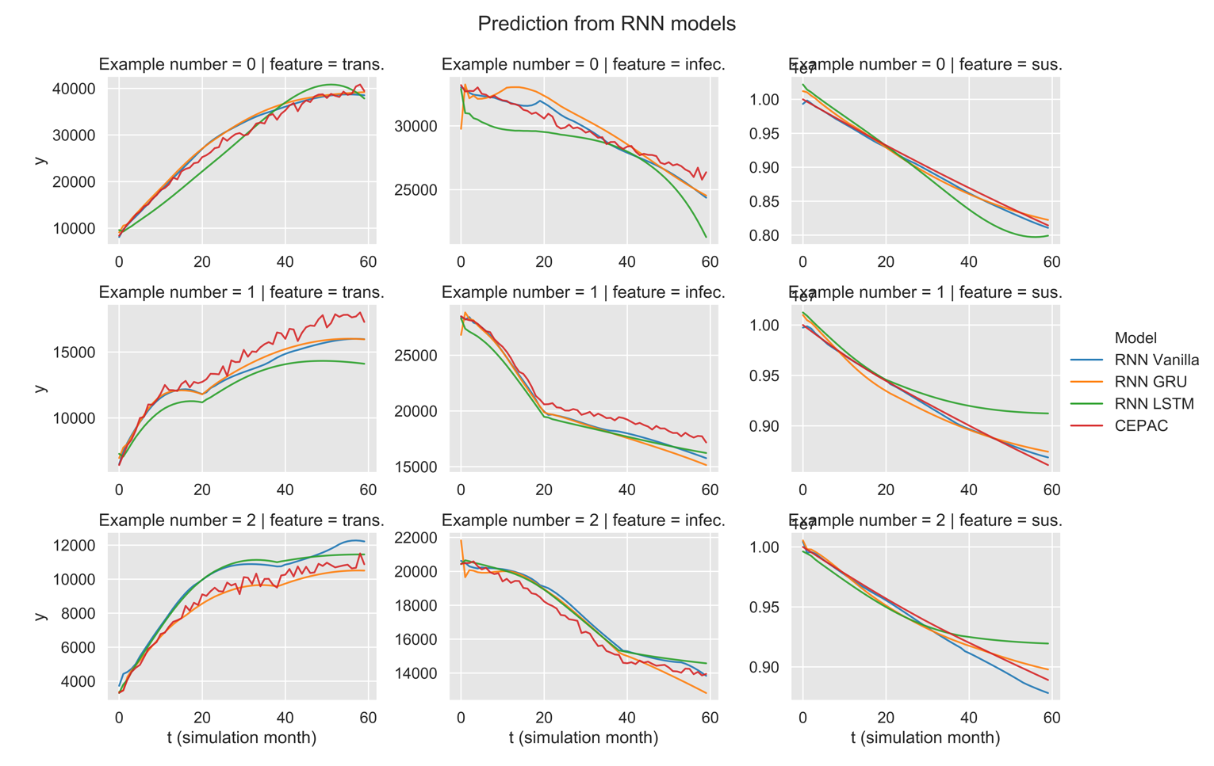
Results

Slide 23
Discussion
Basic mistakes
Not plotting validation error
Setting non-zero ’teacher forcing ratio’ in testing
Constraint on number of parameters was vital
Results are very sensitive to learning rate
Starting value
Reduction by a factor over training period
Cheating MSE
Vanishing gradients

Slide 24
RL model

Slide 25
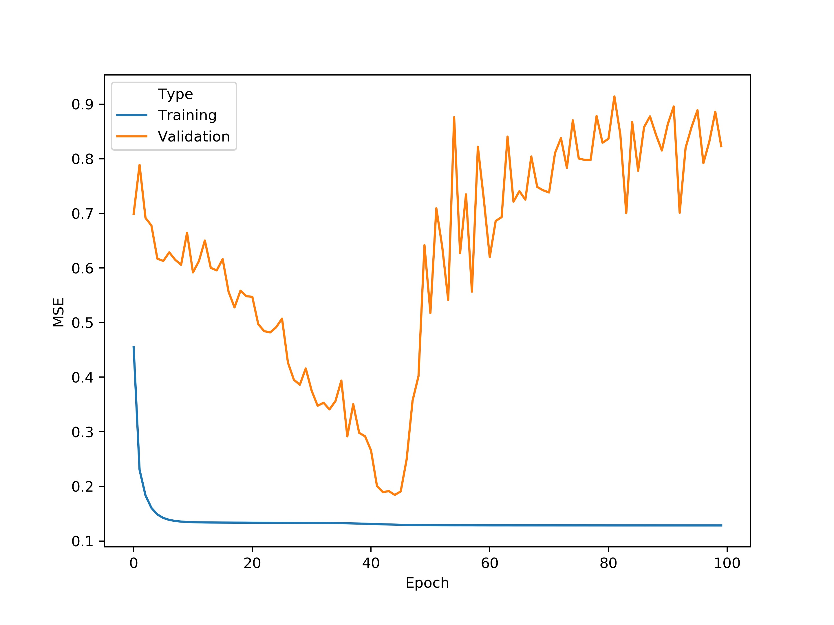
Non-optimal hyperparameter setting

